Slide 1






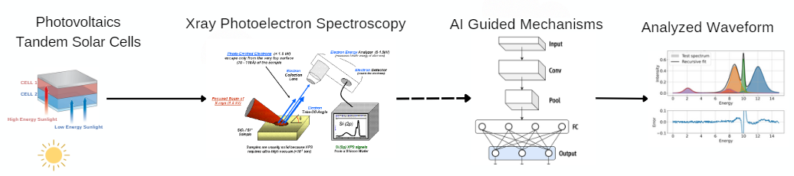
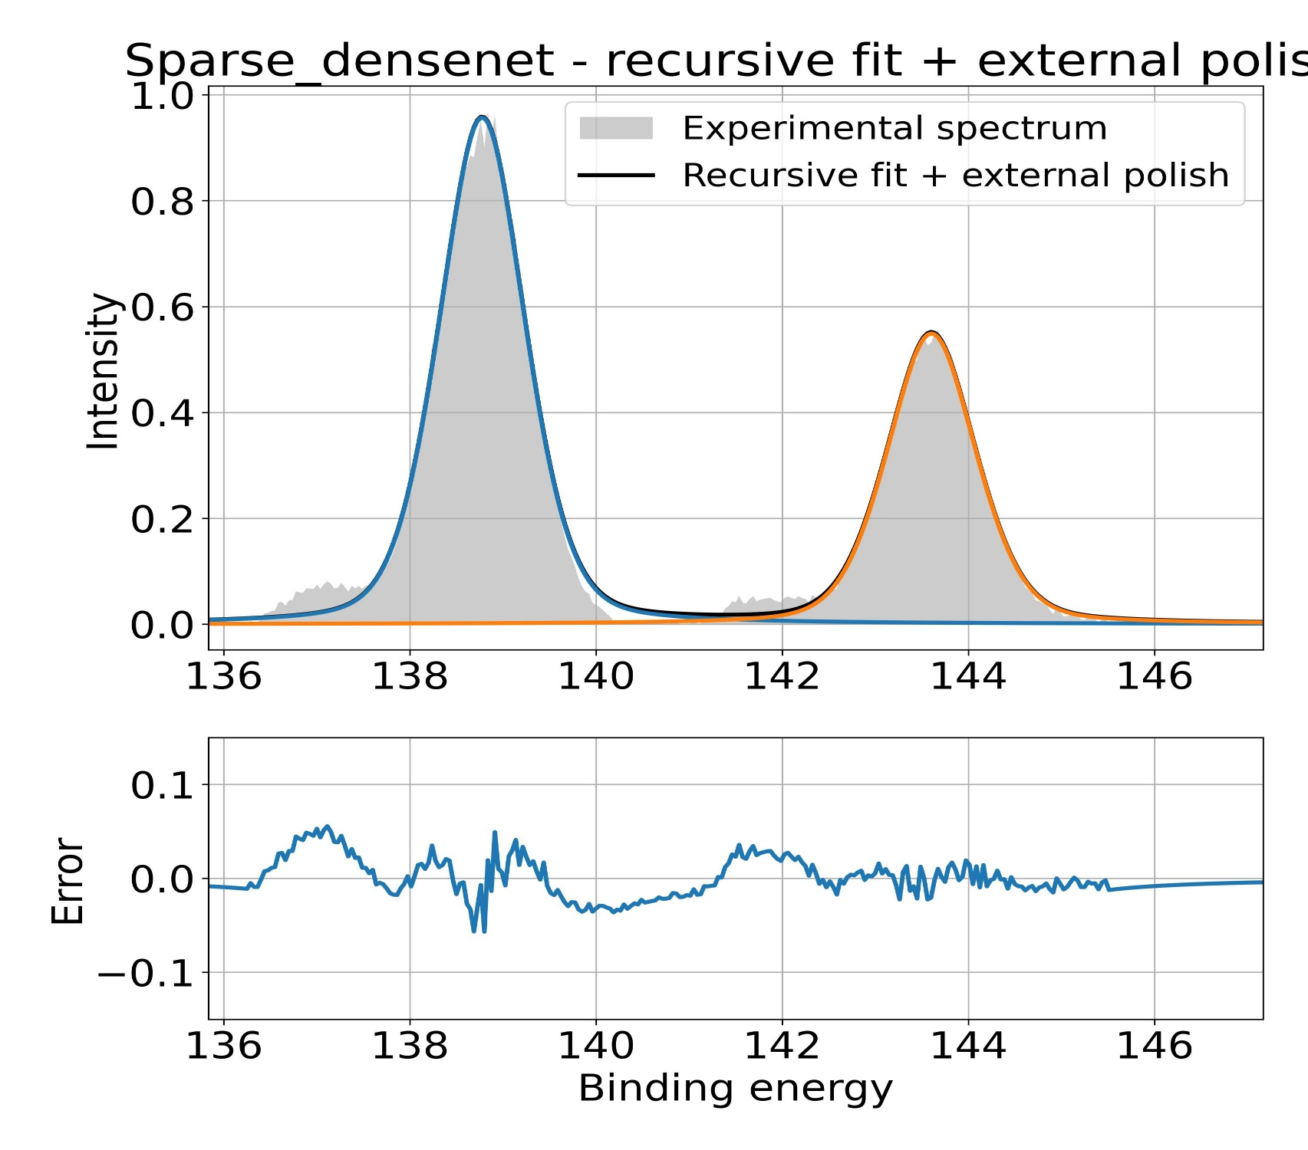
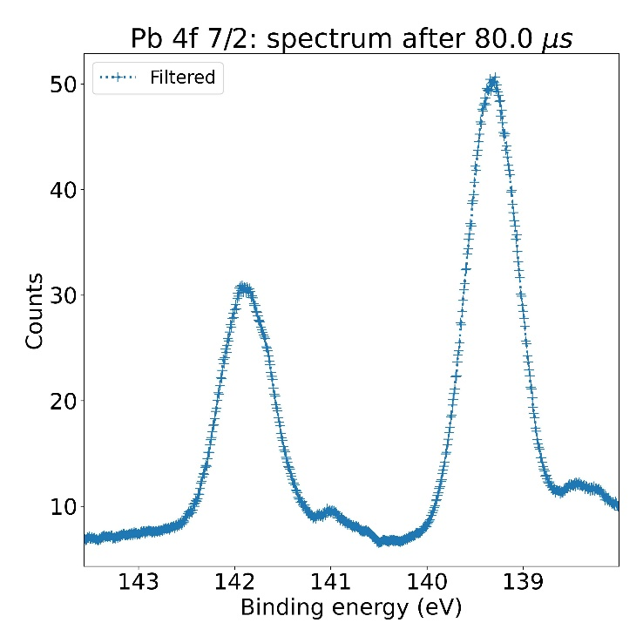
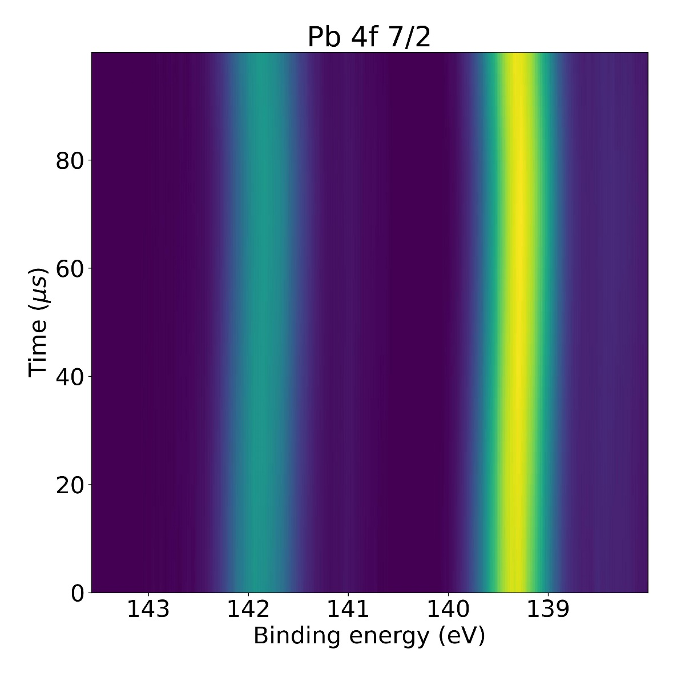
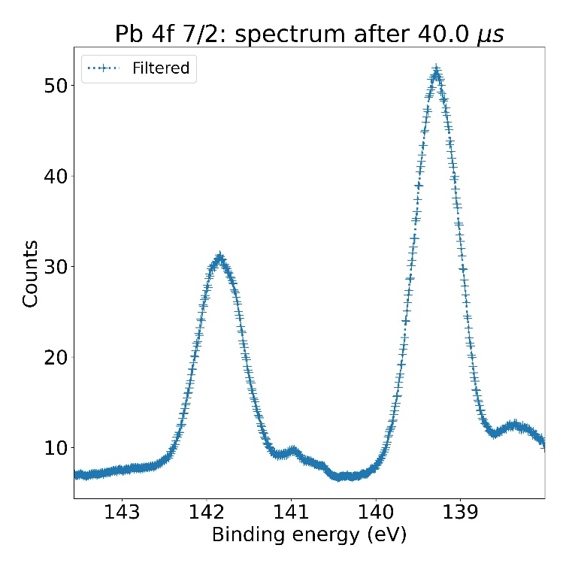
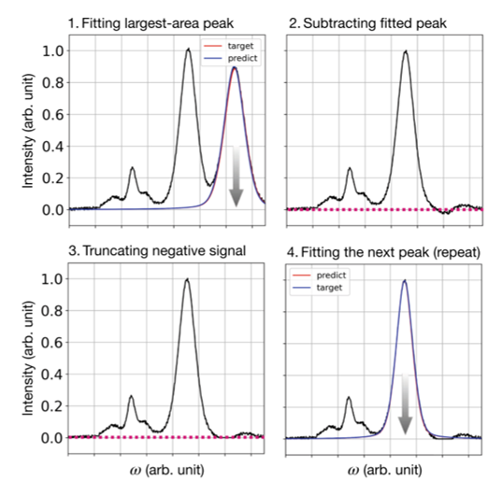
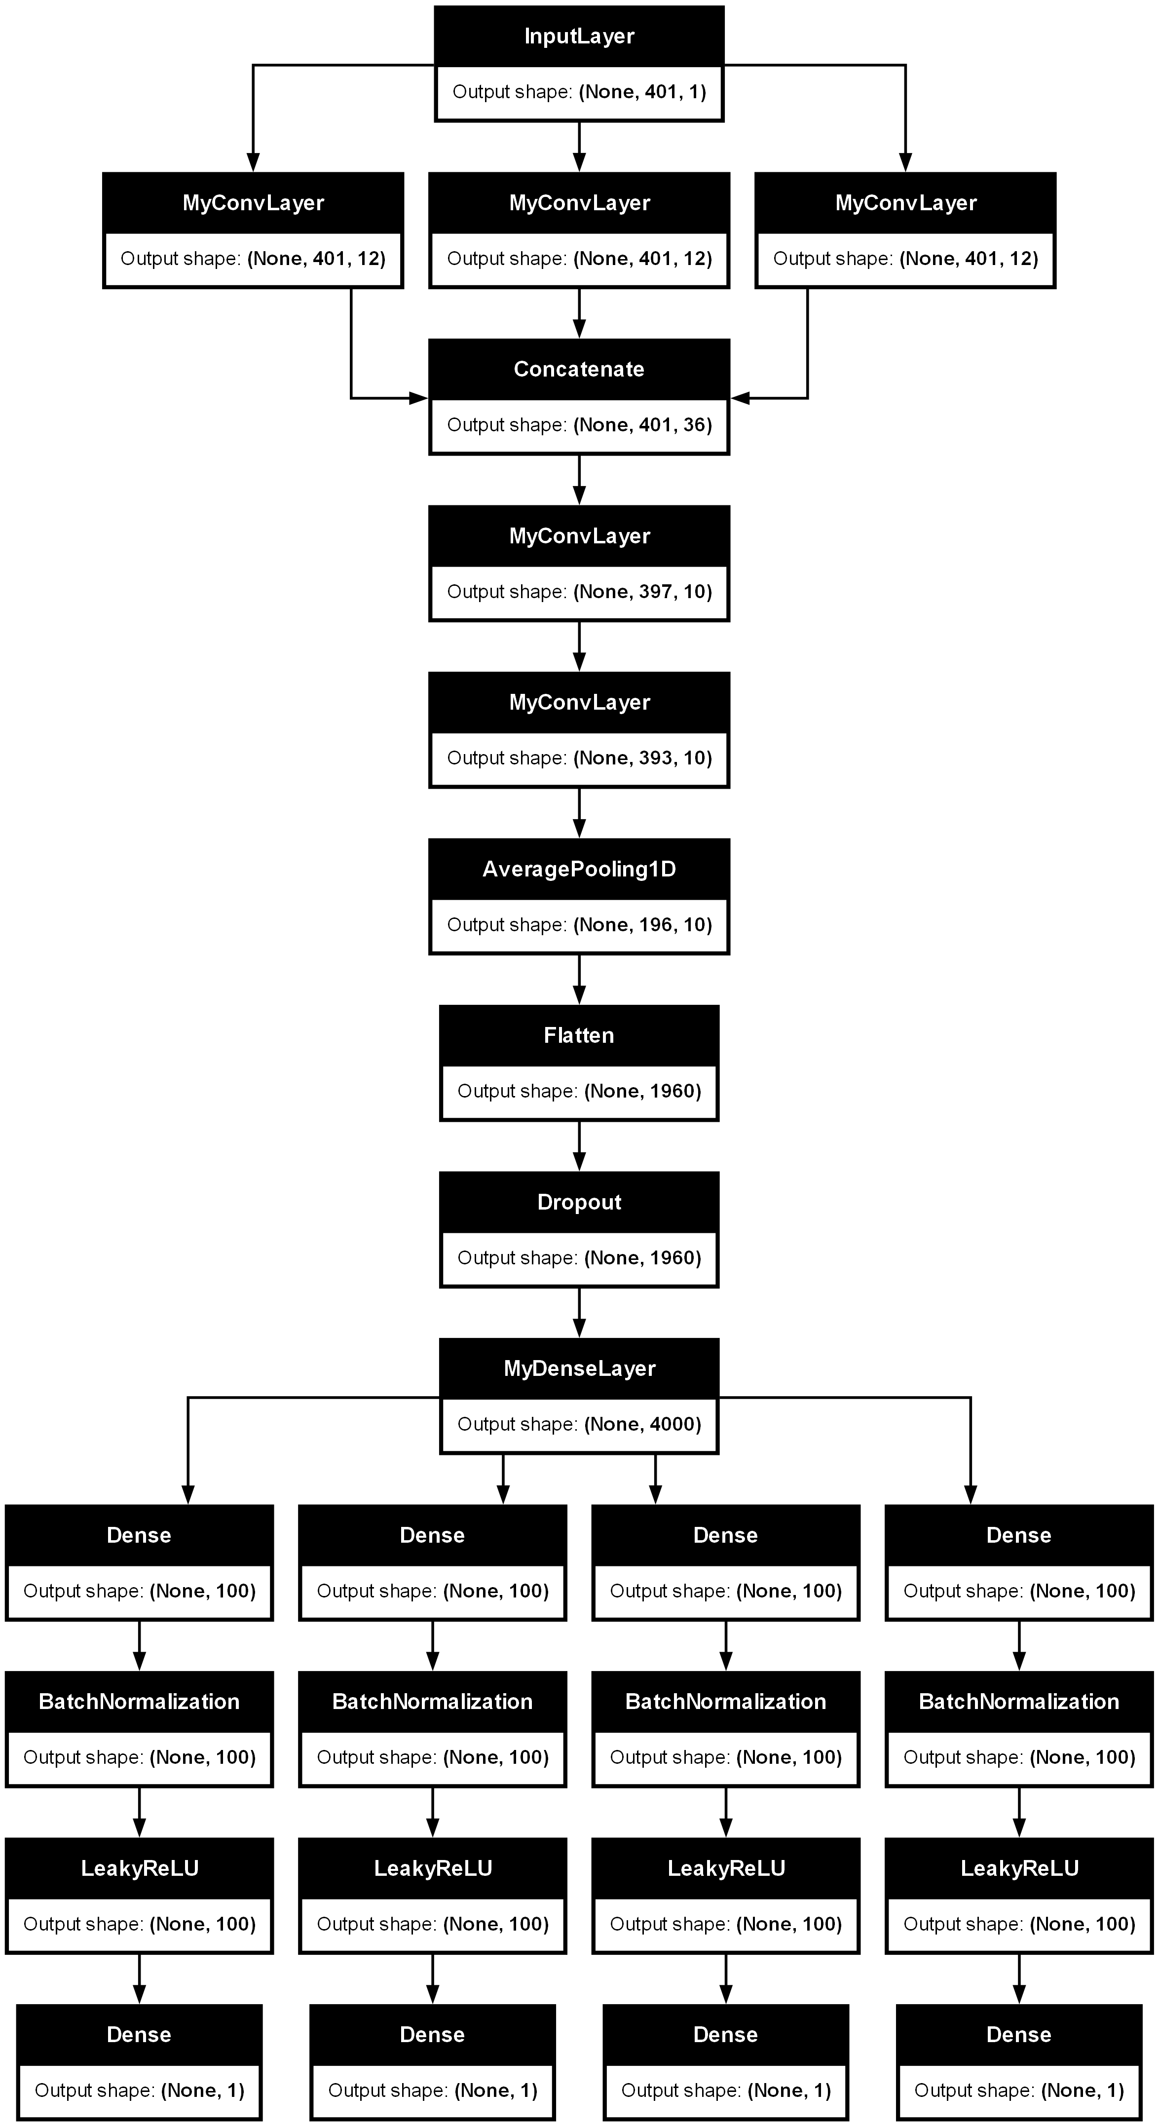
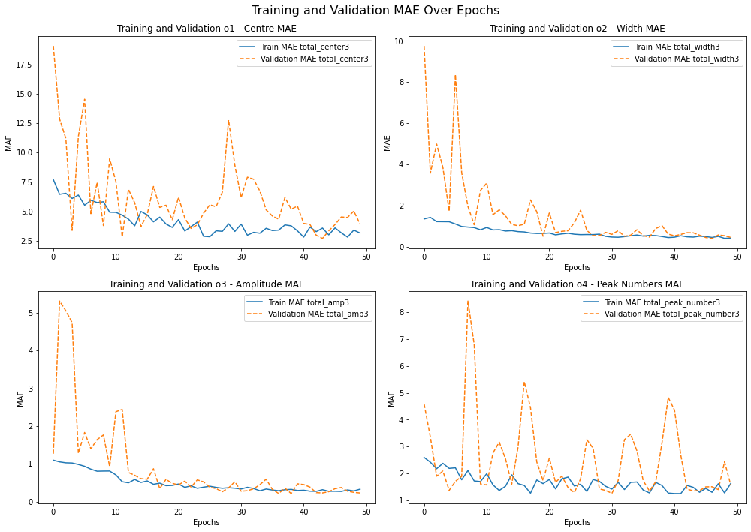



Romaric Sallustre^{1,3,}, Arthur Julien^{2,3}
Jean-Baptiste Puel⁴, Philip Schulz^{2,3}
IPVF Scientific Day 20th June 2024
¹Université Paris Cité
²Institut Photovoltaïque d’Ile de France
³CNRS, Ecole Polytechnique, IPVF, UMR 9006
⁴EDF R&D
Machine Learning Techniques for High-throughout Analyses of TR-PES Measurements
Convolutional Neural Network employed to fit XPS Spectra to quantify chemical states and Electronic properties
→ Work 1 : Optimised CNN Architecture for accurate and precise analysis
→ Work 2 : What are the actual mechanisms limiting the device’s lifetime ?
PROCESS FLOW
Challenges
RESULTS
Time-Resolved X-ray Photoelectron Spectroscopy (TRXPS) generates a vast amount of data under time-resolved constraints. In such scenarios, machine learning algorithms enables accurate and efficient analysis of the extensive spectroscopic
Sparse DenseNet Fitting
Principles
Fitting Time: 43 sec for 100 spectra
1000 XPS spectra to analyze
Bayesian Approach
Spectra Generation of Pb 4f 5/2 and I 4f 7/2
The sequential subtraction technique accurately identifies the total number of peaks by iteratively applying regression to determine and subtract the largest-area peak from the spectrum until no significant peak features remain, ensuring precise and reliable peak determination while avoiding spectral distortions.
Basin-hopping optimization enhances by minimizing residual errors and improving the accuracy of spectrum decomposition into multiple peak functions.
Bayesian Optimization used to fit drift-diffusion model (SimSalabim).
Limits degradation to 6 key parameters.
(2 Shown)
Further fine tuning of fit required
DISCUSSION / CONCLUSIONS
Comparison of V and Δμ:
PL only : all is fine (S1 and S2), slight degradation (S3) → stable material
IV only : severe degradation (S1 and S3) → device is dead
Coupled analysis: collection issues (mobility? interface?)
Pathway analysis:
Shows similar pathways taken by all 3 samples (in case of minor deviation)
Suggests decreasing R_{SH} as the cause of performance degradation
Bayesian Approach:
Validates decrease in R_{SH} and shows an increase in interfacial trap density
Pending Issues
Impact of measurement on aging ?
Accelerated pathways matching real world processes?
Increase statistics : simultaneous measurement of several samples → RotaImpact of measurement on aging ?
Accelerated pathways matching real world processes?
Increase statistics : simultaneous measurement of several samples → Rotating platform/Optical splitting & electrical switching
Study on CIGS with D Lincot to have a 4 Daniel paper
Valorization Corner
Coupled in-situ PL and IV characterization set-up developed for aging measurements
Proof of concept – Upcoming publication
Bayesian analysis – Upcoming publication
Notes:
From here sort out which sample is which

